Slide 1
Bias in Epidemiologic Studies

Slide 2
Bias Can Strike At Any Stage
Preparation
Design and Conduct
Analysis
Interpretation
Publication

Slide 3
Errors in Inference
Error
Random Error
Systematic Error
Selection Bias
Information Bias
Confounding
Random variability that results when using study sample to
estimate population parameters
Errors in participant selection or data collection
Notes:
Remember, last week we noted a difference between structural sources of association and chance (random error, random variability).

Slide 4
Validity and Precision
Error
Random Error
Systematic Error
Selection Bias
Information Bias
Confounding
PRECISION
VALIDITY
Notes:
Recall precision and validity differ. A study could be precise in its statistical inference but invalid due to methodological imperfections.

Slide 5
Bias
Error
Random Error
Systematic Error
Selection Bias
Information Bias
Confounding
BIAS

Slide 6
Definitions of Bias
Systematic error in the design or conduct of a study
Process at any stage of inference which tends to produce results or conclusions that differ systematically from the truth (Sackett, 1979)
Systematic deviation of results or inferences from truth (Porta, 2008)
When we are using data to estimate the causal effect of X on Y, then any association between X and Y that is not due to the effect of X on Y is considered a systematic bias (Hernan, 2020)

Slide 7
Direction of Bias
Positive/Negative
Observed measure of effect is higher/lower than true value
Toward/Away from Null (no effect)
Observed measure of effect is closer/further from the true value
Ratios: Null is 1
Risk Difference: Null is 0

Slide 8
Direction of Bias
True
Observed
Observed
True
Null
Observed
True
Observed₂
Null
True
Observed₁

Slide 9
Bias in Study Design and Conduct
Selection Bias
Prevalence-Incidence/Survival
Non-response bias/Volunteer
Loss to follow-up/Withdrawal
Self-Selection (Membership)
Diagnostic Suspicion
Information
Recall bias
Interviewer
Surveillance (Exposure Suspicion)

Slide 10
Selection Bias
Distortions that result from procedures used to select subjects that influence study participation (Porta, 2008)
Present when probability of being included in a study is dependent on a relevant study characteristic (i.e. exposure, outcome)

Slide 11
Selection Probabilities
 | Population |  | Sample
 | Disease | No Disease | Disease | No Disease
Exposure | A | B | A’ | B’
No Exposure | C | D | C’ | D’
α = A’/A β = B’/B γ = C’/C δ = D’/D
OR = a*d/b*c
α*δ = β*γ no selection bias
α*δ > β*γ ?
α*δ < β*γ ?

Slide 12
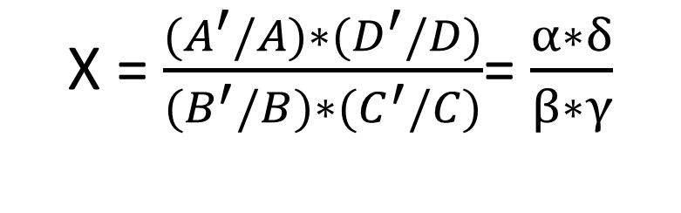
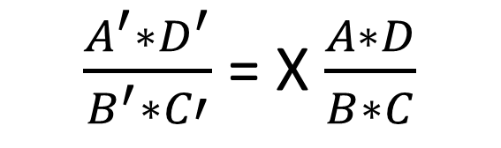
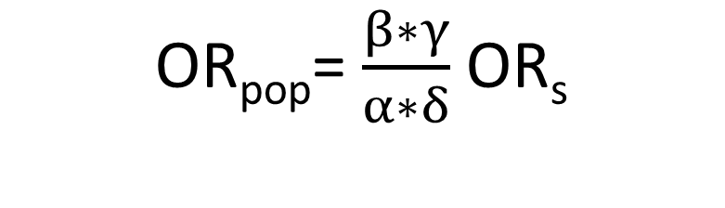
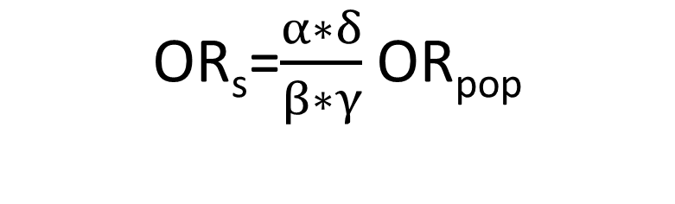
Relationship between Population OR and Sample OR
$\frac{A^{′}∗D^{′}}{B^{′}∗C′}$ = X $\frac{A∗D}{B∗C}$
X = $\frac{{(A}^{′}/A)∗{(D}^{′}/D)}{{(B}^{′}/B)∗(C^{′}/C)}$= $\frac{α∗δ}{β∗γ}$
OR_{s}=$\frac{α∗δ}{β∗γ}$ OR_{pop}
OR_{pop}= $\frac{β∗γ}{α∗δ}$ OR_{s}

Slide 13
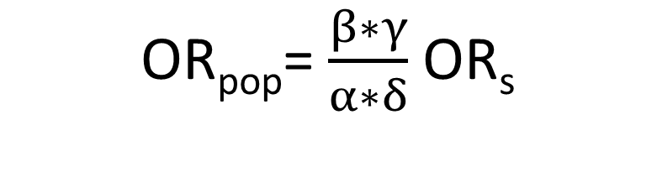
Sampling Fractions and Bias
OR = a*d/b*c
α*δ = β*γ no selection bias
α*δ > β*γ ?
α*δ < β*γ ?
OR_{pop}= $\frac{β∗γ}{α∗δ}$ OR_{s}

Slide 14
Consequences of Selection Bias
Observed association for study sample differs from the association for individuals eligible to participate in study or nonparticipants
The direction of bias is a function of which cells are affected in your contingency table
Adjustment factor can be used for the purposes of sensitivity analyses
In rare cases where sampling fractions are known (two-stage designs, etc), we can adjust for selection bias directly

Slide 15
Incidence Prevalence Bias
Prevalent cases over-represent cases of long duration because those who die or are rapidly cured are less likely to be included

Slide 16

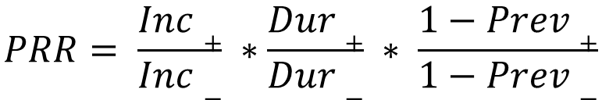
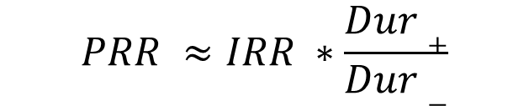
Incidence Prevalence Bias Explained
$$PRR= \frac{Inc+}{Inc−} ∗\frac{Dur+}{Dur−} ∗ \frac{1−Prev+}{1−Prev−}$$
$$Prev=Inc ∗Dur ∗(1−Prev)$$
$$PRR ≈IRR ∗\frac{Dur+}{Dur−}$$

Slide 17
Avoid Incidence Prevalence Bias
Use incident cases
Get exposure history for fatal cases
If using prevalent cases stratify by time since diagnosis

Slide 18
Lab 3 Part 1

Slide 19
Re-looking at Part 1 in Terms of Sampling Fractions
Cross-sectional
Time of Exam 6
12 Years After Baseline Exam
Longitudinal Cohort
Time of Exam 6
12 Year Cumulative Incidence
 | Study 1 |  | Study 2
 | CHD | No CHD | CHD | No CHD
High LDL | 38 | 340 | 85 | 462
Low LDL | 113 | 1170 | 116 | 1511
= 38/85 β = 340/462 γ = 113/116 δ = 1170/1511
= 45% β = 74% γ = 97% δ = 77%

Slide 20
Self-Selection Bias
Selection bias that results because characteristics (usually health-related) of an individual cause the person to either consciously or unconsciously select themselves into certain behaviors or groups.

Slide 21
Exercise and CHD Outcomes
Data has been obtained from different types of study designs using varying definitions of exposure/outcome to ascertain the association between exercise and the risk of CHD outcomes

Slide 22
CHD Mortality and Occupation
Odds of CHD death with and without employment in a physically active occupation: Case-Control Study
Physical Activity Level of Occupation | CHD Deaths | Other Deaths | Total
Heavy | 194 | 668 | 862
Light | 840 | 2029 | 2869
Total | 1034 | 2697 | 3731
OR = ad/bc
OR = 194*2029/668*840
OR = 0.70 (95% CI: 0.59, 0.84)

Slide 23
Recurrent MI and Post-MI Exercise
Relative odds of recurrent MI with and without participation in a graduated exercise program following an initial MI: Cohort Study
Participation Graduate Exercise | Recurrent MI | No Recurrent MI | Total
Yes | 7 | 59 | 66
No | 18 | 46 | 64
Total | 25 | 105 | 130
OR = ad/bc
OR = 7*46/18*59
OR = 0.30 (95% CI: 0.12, 0.78)

Slide 24
Recurrent MI and Endurance Training
Relative odds of recurrent MI with and without endurance training: Randomized Trial
Randomly Allocated to Endurance Training | Recurrent MI | No Recurrent MI | Total
Yes | 28 | 359 | 387
No | 21 | 345 | 366
Total | 49 | 704 | 753
OR = ad/bc
OR = 28*345/359*345
OR = 1.28 (95% CI: 0.71, 2.30)

Slide 25
Cervical Cancer and Sexual Practices
Early studies identified specific behaviors related to sexual practices as risk factors for cervical cancer. These included total number of sexual partners (high) and age of onset of sexual activity (early).
Several studies also reported prevalence proportions of cervical cancer to be approximately two times higher in women who used oral contraceptives (OCs) compared to women who did not use OCs. These studies suggested that OCs might be a causal factor in the development of cervical carcinoma.
Stern et al., proposed that these results might be due to selection bias, in that women who choose oral contraceptives might be different from women who don’t in ways that also affect their risk of cervical cancer.

Slide 26
Does selection bias explain association between OCs and cervical cancer?
In order to investigate this possibility, these investigators obtained the following data from women attending family planning clinics for the first time to obtain contraception (i.e., they had not previously used any form of contraception).
A cervical PAP test was obtained as part of their initial visit. (Cervical dysplasia is considered to be an early or precursor lesion of cervical carcinoma.)
The following results were reported:

Slide 27
Prevalence of Cervical Dysplasia
Method Chosen | Prevalence (per 1000 women)
Oral Contraceptive | 82
Intrauterine Device | 51
Other Method | 36
How Would You Design A Study?
Notes:
In one sentence, how would you interpret these data? That is, what do these data say about cervical dysplasia and method of contraception?
The prevalence of cervical dysplasia at the time women first chose their form of contraception was approximately 1.6 times higher in those who picked oral contraceptives compared to those who chose an IUD, and 2.3 times higher than in women who chose others methods of contraception.
Do the results from this study of Stern, et al. influence the interpretation of previous studies suggesting a causal role for O.C.s in the etiology of cervical cancer? Yes. That is, do they support or refute the idea that self-selection bias explains the previously reported 2-fold association of O.C. use and cervical cancer. Explain your answer.
In this example, women who were choosing a contraceptive for the first time and picked oral contraceptives were more likely to already have cervical dysplasia than women choosing other methods. Because cervical dysplasia is a precursor (early) lesion of cervical cancer, this suggests that women choosing OCs are already at a higher risk of cervical cancer at the time they chose OCs. This would be consistent with self-selection bias – that some characteristic of the individual either consciously or unconsciously influences their choice of behaviors. What is that characteristic(s)?
Epidemiologic studies of risk factors for cervical cancer indicated that several behaviors related to sexual practices were associated with the disease. These include early age at first intercourse, and especially, multiple sexual partners. Cervical cancer is now known to be a sexually transmitted disease, with the human papilloma virus (HPV) playing a large role. Thus, highly sexually active women are more at risk (since every new partner increases the probability of exposure) and highly sexually active women are more likely to choose oral contraceptives than other forms of contraception. This is reflected in the higher prevalence of cervical dysplasia in those whose first-time choice was OCs.
This example illustrates several other points:
the importance of knowing about the natural history of the disease you are studying (how does it manifest and progress; are there earlier manifestations of its development that can be measured?, etc.)
the importance of understanding what is already known about risk factors for the disease – e.g., number of sexual partners as a risk factor.

Slide 28
Guard Against Self-Selection Bias
Use methods that you would use to manage confounding
Restriction
Matching
Stratified Analysis
Cohort design
Follow-up to determine cancer incidence, restrict to population w/out dysplasia at baseline

Slide 29
Diagnostic-Suspicion Bias
Occurs when knowledge of the person’s exposure status to a suspected causal factor influences both the intensity and outcome of the diagnostic process
a.k.a. surveillance bias

Slide 30
Identify Diagnostic-Suspicion Bias
Stratify cases or diseased by how certain the diagnosis is thought to be (e.g. possible, probable and definite)
Compare measure of effect across strata
As certainty of diagnosis increases, the likelihood of diagnostic-suspicion bias is less

Slide 31
Oral Contraceptives and Risk of Thrombo-Embolic Disease
Percentage of Cases Using Oral Contraceptives by Type of Diagnosis and Certainty
 | Certainty of Diagnosis
Case DX | Possible | Probable | Certain
Idiopathic DVT | 3/9 (33) | 17/37 (46) | 1/1 (100)
Idiopathic PE | 2/4 (50) | 5/10 (50) | 4/4 (100)
Idiopathic DVT + PE |  | 4/10 (40) | 10/17 (59)
Post-operative DVT | 1/6 (17) | 3/8 (38) | 1/1 (100)
Post-operative DVT | 0/3 (0) | 5/8 (63)
Post-operative DVT + PE |  |  | 3/7 (43)
Source: Vessey 1971

Slide 32
Avoid Diagnostic-Suspicion Bias
Use blinding to hide exposure status when ascertaining diagnosis
Use only definite cases

Slide 33
Non-Response Bias/Volunteer
Selection bias that occurs when response rates of participants in a study differ; people who agree to participate are different in terms of exposure or other important characteristics from those who do not agree
a.k.a. Loss-to-follow-up/Withdrawal (Prospective Cohort)

Slide 34
Recognizing Non-Response Bias
Cannot be identified by comparing case/control response proportions alone
Non-response among participants could be equal with bias or unequal with no bias
Bias occurs when exposure frequency differs among subgroups
Participants vs. Non-Participants
Cases or Controls

Slide 35
Effects of Non-Response Bias Vary
Given factors related to non-response, direction of bias may be towards/away from null
Overestimated/underestimated exposure among controls could lead to lower or higher effect estimate
If proportion of non-response is equal, effect estimate is unchanged (no bias)

Slide 36
Avoid Non-Response Bias in Case Control Studies
Selection of exposed/unexposed should be done without knowing the outcome
Exposure frequency among control group should reflect exposure of population that gave rise to cases
Controls should be selected independent of exposure status
Use good definitions of exposure and outcome

Slide 37
Avoid Non-Response Bias in Cohort Studies
Only way to avoid loss to follow-up is to maintain high follow-up
Make sure you can track participants
Make measurements as easy to complete as possible for the research question
Provide incentives for maintaining study participation
Maintain high levels of motivation and interest in your study population
Adjustments for loss to follow-up can be made if predictors of attrition are measured at baseline
Inverse probability of censoring weighting

Slide 38
Prevention & Control of Bias
Assessed in context of specific study design, methods and procedures
Assure study design is appropriate for hypotheses being tested
Use standardized procedures for data collection and monitor to see they are valid and reliable

Slide 39
Lab 3 Part 2

Slide 40
Introduction to Measurement and Measurement Error

Slide 41
A Brief Note on Measurement Error
Measurement error is not a characteristic of a given measurement tool
Measurement error is the result of applying a specific measurement tool to a specific research question, with a specific group, at a specific time
Why is this distinction important?

Slide 42
Reliability
If the true value is constant, a highly reliable measure will produce the same value repeatedly
How consistently are items measured?
Across time
Across items
Between raters

Slide 43
Measures of Reliability (Continuous)
Intraclass Correlation Coefficient
Partitions variance of measures into within and between person variances
Ranges from 0 to 1
When the within person variance is low, we expect the reliability to be high
Pearson’s R
Not considered suitable for a measure of reliability
Measures a linear relationship, not agreement
$$ICC=\frac{σ_{B}^{2}}{σ_{B}^{2}+ σ_{w}^{2}}$$

Slide 44
Measures of Reliability (Categorical)
Kappa
Measures agreement between categorical variables while correcting for chance agreement
Note that the numerator for kappa can never exceed the denominator
P_{e} is calculated based on table margins to see what proportion of would you expect to fall into the concordant cells by chance alone (see textbook)
$$κ=\frac{P_{o} − P_{e}}{1 − P_{e}}$$

Slide 45
Lab 4 Part 1

Slide 46
Validity
How close to the truth are we?
Closely tied with the idea of bias
A measure can be reliable but not valid, but a valid measure is always reliable

Slide 47
Estimation
Accurate and Precise
Precise but not Accurate
Neither Accurate nor Precise

Slide 48
Model for Continuous Measurement Error
X is the observed measurement
T is the true measurement
b is the bias
E is random error (mean is expected to be zero, μ_{E}=0)
$$Xi=Ti+b+Ei$$

Slide 49
Bias and Precision (Continuous)
Our model for measurement error makes a distinction between systematic and random error
Since μ_{E =0}
b= μ_{x} - μ_{t}
The variance of E_{i} ,σ²_{E}, shows the precision of the measure

Slide 50
Differential Measurement Error (Continuous)
Example
We have a case-control study with a continuous exposure measure. What are the consequences of measurement error in our exposure? Could measurement error vary from cases to controls?
We need to extend our model
Differential Measurement Error
$bcases$ $≠bcontrols$
$$XiCases=TiCases+bcases+EiCases$$
$$XiControls=TiControls+bcontrols+EiControls$$

Slide 51
Consequences of Differential Measurement Error (Continuous)
Relationship between the odds of disease and the true exposure can be expressed in the following logistic regression
$$\log\left[\frac{\operatorname{Pr}\left(d\right)}{1−\operatorname{Pr}\left(d\right)}\right]= α_{T}+ β_{T}T$$
$β_{T}$ = $\frac{μ_{TCases}− μ_{TControls}}{σ_{T}^{2}}$

Slide 52
Consequences of Differential Measurement Error (Continuous)
Relationship between the odds of disease and the observed exposure can be expressed in the following logistic regression
$$\log\left[\frac{\operatorname{Pr}\left(d\right)}{1−\operatorname{Pr}\left(d\right)}\right]= α_{O}+ β_{O}X$$
$β_{O}$ = $\frac{(μ_{TCases}− μ_{TControls) + (b_{Cases} − b_{controls})}}{σ_{T}^{2}+ σ_{E}^{2}}$

Slide 53
Relationship between True Log Odds and Observed Log Odds (Continuous)
So the magnitude and direction of the bias in the observed log odds will depend on the bias in the cases, the bias in the controls, and the correlation between the true and observed exposure values
This can bias the observed log odds in any direction!!!
When are the observed and true log odds equal?
$β_{0}=(1+ \frac{b_{Cases} − b_{Controls}}{μ_{TCases} − μ_{TControls}}) ρ_{TX}^{2}B_{T}$

Slide 54
Consequences of Non-Differential Measurement Error (Continuous)
For non differential measurement error
$b_{Cases}= b_{Controls}$
So the relationship between the true and observed log odds simplifies to:
Since $ρ_{TX}^{2}$ ranges from 0 to 1, the observed log odds will on average be lower than the true log odds
$β_{0}=ρ_{TX}^{2}B_{T}$

Slide 55
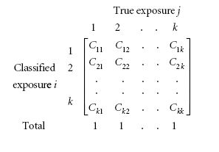
Categorical Measurement Error
Misclassification matrix relating the true exposure (j) and the classified exposure (i) for k categories
C_{ij} is the proportion of true exposures in category j classified into category i
Note each column sums to 1
What would a matrix with no measurement error look like?

Slide 56
Misclassification of Binary Variables
When we have binary measurements, the misclassification matrix simplifies to:
Sensitivity
The probability of being classified as exposed when you are truly exposed
Specificity
The probability of being classified as unexposed when you are truly unexposed
 | True Value
Classified Value | + | -
+ | Sensitivity | 1-Specificity
- | 1- Sensitivity | Specificity

Slide 57
Misclassification Bias in Epidemiology
Incorrect assignment of exposure or disease status of an individual to a category to which it should not be assigned
Examples
Cases incorrectly classified as controls
Controls incorrectly classified as cases
Exposed incorrectly classified as non-exposed
Non-exposed incorrectly classified as exposed

Slide 58
Non-differential Misclassification
Sensitivity and specificity of:
Exposure is not dependent on disease status or
Disease is not dependent on exposure status
Equal misclassification of:
Exposure between diseased and non-diseased subjects or
Disease between exposed and non-exposed subjects

Slide 59
Differential Misclassification
Sensitivity and specificity for:
Exposure is dependent on the disease status
Disease is dependent on exposure status
Non-equal misclassification of:
Exposure between diseased and non-diseased subjects
Disease between exposed and non-exposed subjects

Slide 60
Consequences of Misclassification
Non-differential: unrelated to occurrence of exposure/outcome
On average, results in a measure of effect biased towards the null with a binary outcome
Differential: related to occurrence of exposure/outcome
Measure of effect may be biased towards or away from null

Slide 61
Caveats for Non-Differential Misclassification
Just because non-differential measurement error will on average bias an estimate toward the null does not mean a specific estimate is biased towards the null
Random error alone may cause the observed estimate to be further away from the null than the true estimate
Particularly problematic in epidemiology where we commonly have large CIs
All bets are off if non-differential errors in the disease and exposure are correlated with each other

Slide 62
Calculating Sensitivity and Specificity of Exposure
 | SENSITIVITY: TP ÷ (TP + FN)
 | SPECIFICITY: TN ÷ (TN + FP)
TRUE | CASES |  | CONTROLS
 | EXP (+) | UNEXP (-) | EXP (+) | UNEXP (-) | TRUE OR
 | A | C | B | D | [A/C ÷ B/D]
OBSERVED |  |  |  |  | OBS OR
EXP (+) | TP | FP | TP | FP | [a/c ÷ b/d]
UNEXP (-) | FN | TN | FN | TN
 | A | C | B | D
a
b
c
d

Slide 63
Calculating Sensitivity and Specificity of Disease
 | SENSITIVITY: TP ÷ (TP + FN)
 | SPECIFICITY: TN ÷ (TN + FP)
TRUE | EXPOSED |  | UNEXPOSED
 | CASE (+) | CONTROL (-) | CASE (+) | CONTROL (-) | TRUE RR [A/ A+B ÷ C/C+D]
 | A | B | C | D
OBSERVED |  |  |  |  | OBS RR
CASE (+) | TP | FP | TP | FP | [a/a+b ÷ c/c+d]
CONTROL (-) | FN | TN | FN | TN
 | A | B | C | D
a
c
b
d

Slide 64
Assess Impact of Misclassification
Use Se to calculate the TP among exposed and non-exposed or disease and non-diseased
Use Sp to calculate the TN among exposed and non-exposed or disease and non-diseased
Use simple algebra to determine FP and FN
Reconstruct contingency table using adjusted cell counts (a, b, c, d)

Slide 65
Assess Impact of Misclassification
Calculate a new measure of association using updated contingency table
Describe the impact, if any that misclassification has on your measure of association
On average, do you expect it to be biased towards/away from null?
How can sensitivity or specificity explain any bias in your estimate?
On average, are your over/under-estimating exposure or disease in a particular group?

Slide 66
Assess Impact of Misclassification
In practice, steps 1 and 2 are an algebraic nightmare (see Modern Epidemiology, 2nd edition, chapter 19 for proof)
Sensitivity and specificity rates usually must be calculated from a validation sub-sample
If a validation subsample exists, we can us multiple imputation to incorporate the validation subsample and calculate an estimate adjusted for misclassification

Slide 67
Which scenario describes non-differential misclassification?
Scenario 1
Scenario 2
15% of women exposed to radiation were categorized as being non-exposed
15% of women not exposed to radiation were categorized as being exposed
20% of women exposed to radiation were classified as being unexposed
0% of women not exposed to radiation were classified as being exposed

Slide 68
Lab 4 Part 2

Slide 69
Information Biases Common to Epidemiology

Slide 70
Information Bias
Distortion in the measure of association resulting from systematic error in the assignment of either exposure or outcomes
Most likely to occur at state of data collection
Can occur at virtually any stage in the study

Slide 71
Sources of Information Bias
Bias in abstracting records
Bias in interviewing
Bias from surrogate interviews
Surveillance bias
Reporting and recall bias

Slide 72
Error Adds Up
In epidemiological studies, sensitivity and specificity can vary for measurements of:
Exposure
Outcome
Confounders

Slide 73
Biases in Questionnaire Studies
Way a question is designed
vague wording, leading, intrusive, inconsistent
Way a questionnaire is designed
format, length, skipping patterns
How the question is administered
interviewer nonblinding, unacceptability, recall, cultural
Choi and Pak. A Catalog of Biases in Questionnaires. Prev Chronic Disease [serial online] 2005. Available from URL:
http://www.cdc.gov/pcd/issues/2005/jan/04_0050.htm

Slide 74
Recall Bias
Bias that results in the misclassification of exposure due to the inaccurate recall of exposure status
Case-Control Studies
Differential: error differs between cases and controls
Non-Differential: error is same between cases and controls

Slide 75
Ascertainment of Recall Bias
Notes:
In a case-control study of the association of in utero exposure to radiation and subsequent risk of childhood leukemia, the investigators asked mothers of cases and controls about many different types of X-ray exposure during pregnancy and of the child after birth. The figure below shows the percent of cases and controls reporting each type of exposure. Are these data consistent or inconsistent with recall bias as an explanation for a positive association between fetal exposure to radiation and subsequent risk of leukemia? Explain your answer.
Answer: Inconsistent, since the greater frequency of exposure in cases is seen only for the exposure of interest (i.e., abdominal x-ray during pregnancy) and not for the other types of x-rays. (Participants NOT told of the research hypothesis)

Slide 76
Prevent Recall Bias
Verify Participant Responses
Medical or pharmacy records
Use of Diseased and Healthy Controls
Introduce similar bias in exposure odds of controls
Use of Objective Markers of Exposure
Less prone to recall bias
Ask about related exposures that are unlikely causal
Use of Cohort Study Design (nested case-control)

Slide 77
Interviewer Bias
Systematic error in soliciting, recording or interpreting information from study subjects based on their exposure/disease status
Case-Control Studies
Result in overestimation of association between exposure and disease

Slide 78
Toxic Shock Syndrome & Tampons
Interviewers probed more extensively for past tampon use in cases than in controls
Over-estimated association between tampon use and toxic-shock syndrome (OR=7.6)
Exposure validation lead to attenuation of measure of association (OR=5.3)

Slide 79
Prevent Interviewer Bias
Blind interviewers to disease status
Standardized data collection procedure(s)
Monitoring of data collection process
Can assess in a validation sub-study

Slide 80
Exposure Suspicion Bias
Knowledge of a patient’s disease status may influence the intensity and result of a search for exposure
a.k.a. surveillance bias
Notes:
Both recall bias and interviewer bias have “exposure suspicion” as the mechanism for the bias.
For recall bias, the participants themselves are responsible for the bias. For instance, If those who are sick suspect an occupational origin to their disease, they may try to remember as accurately as possible all of the dangerous agents to which they may have been exposed while on the job. When handling undefined products, they may be more inclinded to recall the names of precise chemicals, particularly if a list of suspected agents is made available to them. In contrast, controls may be less likely to go through the same thought process.
With interviewer bias, the interviewer may or may not be aware of the study hypothesis. But may be aware that certain exposures can cause the disease under study. For example, in a case-control study of bladder cancer, study staff may be well aware of the fact that certain chemicals such as aromatic amines are risk factors for bladder cancer. If they also know who has developed the disease and who has not, they may be likely to conduct more indepth interviews with the cases than with the controls – insisting on more detailed information on past occupations and search systematically for exposure to aromatic amines, whereas for controls they may record occupation in a more routine way. The resulting bias is also known as exposure suspicion bias.

Slide 81
Reduce Information Bias
Use the best possible tool to measure exposure and outcomes
Use objective (“hard”) measures as much as possible
Use blinding as often as possible, especially for subjective outcomes
Train interviewers and perform standardization (pilot) exercises

Slide 82
Reduce Information Bias
Verify information using multiple sources (cross-check)
Standardize data collection procedures for collecting exposure information from cases and controls [case-control study]
Use the same procedures to diagnose disease outcomes in exposed and unexposed [cohort study and RCTs]

Slide 83
Reduce Information Bias
Collect data on sensitivity and specificity of the measurement tool
Collect data on reliability of measures (e.g. inter-rater agreement)
Use a stronger study design: e.g. RCT, cohort and nested case-control where exposures are measured before disease occurs

Slide 84
Reduce Information Bias
Correct misclassification for imperfect sensitivity and specificity of the
Perform sensitivity analysis: range of plausible estimates given misclassification

